Slide 1

Machine Learning for Engineers: K-Means Clustering
Mina Farmanbar
Associate Professor, University of Stavanger
for engineers

Slide 2
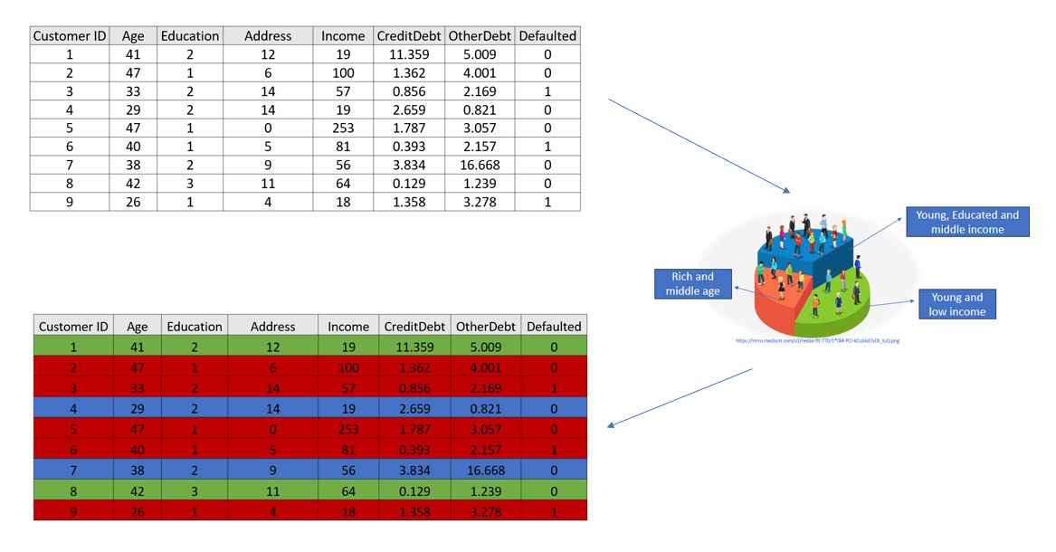
Customer Segmentation

Slide 3
K-Means Clustering
K-Means can group data based on the similarity of customers to each other.
Partitioning Clustering
It divides the data into pre-defined non-overlapping subsets (clusters)
K-means is a centroid-based algorithm or a distance-based algorithm, where we calculate the distances to assign a point to a cluster.
In K-Means, each cluster is associated with a centroid.

Slide 4
K-Means Clustering
Objects within a cluster are very similar, and objects across different clusters are very different or dissimilar.
How do we measure how similar two customers are
regarding their demographics?

Slide 5
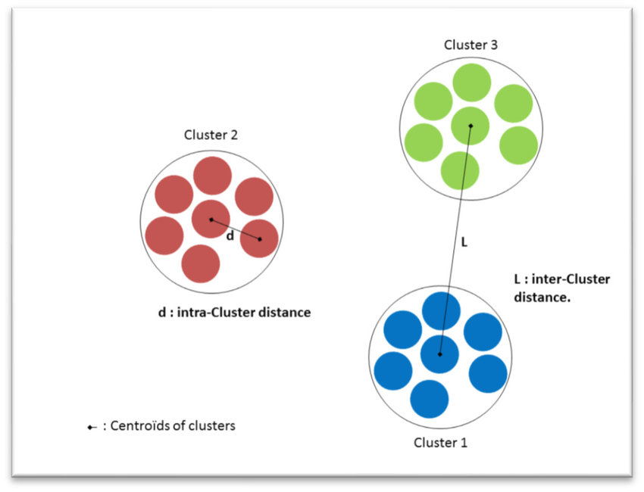
K-Means Clustering
Distance of samples from each other is used to shape the clusters.
K-Means tries to minimize the intra-cluster distances and maximize the inter-cluster distances.
https://dataaspirant.com/wp-content/uploads/2020/12/8-Intra-Cluster-Distance-and-Inter-Cluster-Distance-768x449.png

Slide 6
K-Means Clustering
How to compute the similarity between cases?

Slide 7


Computing the similarity between cases
$$d\left(p,q\right)= \sqrt{\sum_{i=1}^{n}{{( q_{i} −p_{i})}^{2}}}$$
Customer 1
Age
34
Customer 2
Age
30
$$= \sqrt{{( 34 −30)}^{2}}=4$$
Euclidian Distance

Slide 8
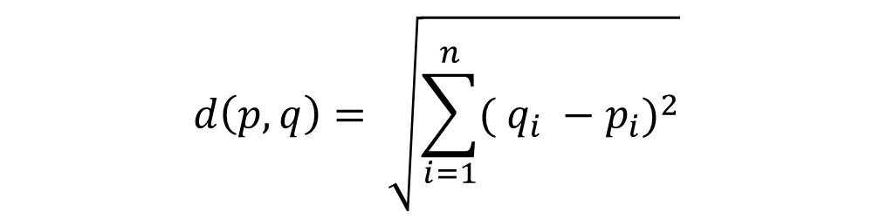
K-Means Clustering
$$d\left(p,q\right)= \sqrt{\sum_{i=1}^{n}{{( q_{i} −p_{i})}^{2}}}$$
Customer 1
Age | Income
34 | 190
Customer 2
Age | Income
30 | 200
$$= \sqrt{{( 34 −30)}^{2}+{( 190 −200)}^{2}} = 10.77$$
Age distance
Income distance

Slide 9
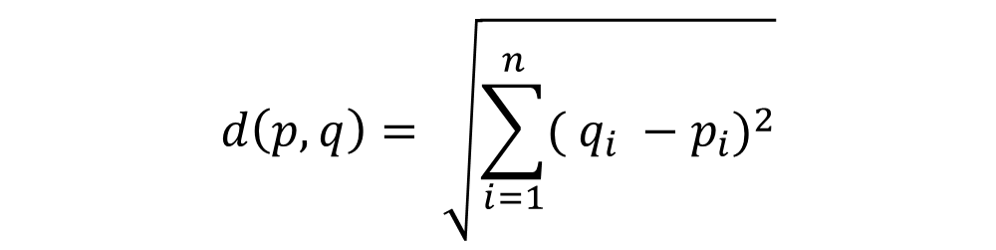
K-Means Clustering
$$d\left(p,q\right)= \sqrt{\sum_{i=1}^{n}{{( q_{i} −p_{i})}^{2}}}$$
Customer 1
Age | Income | Education
34 | 190 | 3
Customer 2
Age | Income | Education
30 | 200 | 8
$$= \sqrt{{( 34 −30)}^{2}+{( 190 −200)}^{2}+{( 3 −8)}^{2}} =11.87$$
Age distance
Income distance
Education distance

Slide 10
K-Means Clustering
Of course, we have to normalize our feature set to get the accurate dissimilarity measure.
Min-Max scaling
Z-Score Normalization (Standardization)

Slide 11
Dissimilarity measures
For example, you may use
Euclidean distance,
Cosine similarity,
Average distance, and so on.
It is highly dependent on datatype and also the domain that clustering is done for it

Slide 12
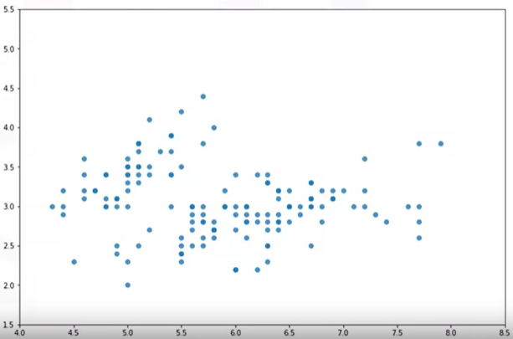
K-Means Clustering
Customer ID | Age | Income
1 | 3 | 4
2 | 2 | 6
3 | 5 | 5
… | … | ….
Income
Age

Slide 13
K-Means Clustering
Initialize K = 3 centroid
Randomly choose from dataset
Create random points
Distance Calculation
Calculate the distance of each
data point from the centroid points
Assign each customer to the closest
center.
C1 | C2 | C3
5 | 20 | 15
C1
C2
C1 | C2 | C3
d(p1, C1) | d(p1, C2) | d(p1, C3)
d(p2, C1) | d(p2, C2) | d(p2, C3)
d(p3, C1) | d(p3, C2) | d(p3, C3)
d(p4, C1) | d(p4, C2) | d(p4, C3)
d(pn, C1) | d(pn, C2) | d(pn, C3)
Income
C3
Age
Distance Matrix

Slide 14

K-Means Clustering
The main objective of K-Means clustering is to minimize the distance of data points from the centroid of this cluster and maximize the distance from another cluster.
C1 | C2 | C3
d(p1, C1) | d(p1, C2) | d(p1, C3)
d(p2, C1) | d(p2, C2) | d(p2, C3)
d(p3, C1) | d(p3, C2) | d(p3, C3)
d(p4, C1) | d(p4, C2) | d(p4, C3)
… | … | …
d(pn, C1) | d(pn, C2) | d(pn, C3)
C1
C2
Income
C3
Distance Matrix
Error = the sum of the squared differences between each point and its centroid.
Age
Error = $\sum_{i=1}^{n}{{( x_{i} −C_{i})}^{2}}$

Slide 15
K-Means Clustering
Intuitively, we try to reduce this error. It means we should shape clusters in such a way that the total distance of all members of a cluster from its centroid be minimized.
The question is,
how can we turn it into better clusters with less error?

Slide 16
K-Means Clustering
Each cluster center will be updated to be the mean for datapoints in its cluster.
Note that whenever a centroid moves, each point's distance to the centroid needs to be measured again.
We repeat until there are no more changes in the centroids
C1
C2 (7.6, 3.7)
A(7.4, 3.6)
B(7.8, 3.7)
Income
C3
Income
Age
Age

Slide 17
Summary
As it is a heuristic algorithm, there is no guarantee that it will converge to the global optimum and the result may depend on the initial clusters.
It means, this algorithm is guaranteed to converge to a result, but the result may be a local optimum i.e. not necessarily the best possible outcome.

Slide 18
Summary
To solve this problem, it is common to run the whole process multiple times with different starting conditions.
This means with randomized starting centroids, it may give a better outcome.
As the algorithm is usually very fast, it wouldn't be any problem to run it multiple times.

Slide 19
Thank you!
Mina Farmanbar
mina.farmanbar@uis.no

